Slide 1
Application Specific Image Feature Extractor
Submitted by
SOUHAM BISWAS
B.Tech CSE VIIth Sem.

Slide 2
Software Overview -
This application utilizes computer vision to automatically identify objects available at a departmental store; a more versatile replacement of the common bar-code scanner.
This application seeks to speed up the billing process by replacing the bar-code scanner with a camera. The commodity to be billed may be placed in any orientation in front of the camera. The application will click a snapshot of the same, analyse the image and subsequently add the corresponding price of the commodity to the customer’s bill.

Slide 3
Application Features
Hardware Peripheral Independent–
The application has been designed to be independent to the maximum extent of the underlying hardware on which it is operating.
Automatic Background Removal–
The application has an inbuilt algorithm to remove the background of the object placed in front of the camera and this algorithm is impervious to the lighting conditions of the environment of operation .

Slide 4
Modularity–
The software has been developed in a modular manner. The modules will have the capability to be deployed in other scenarios. Therefore, provision to interface new modules and functionality will be provided.
Cheap and powerful alternative –
This can be easily used in place of a bar-code scanner at no extra cost. Hence, it is pretty much a cheap and powerful alternative.

Slide 5
Software Pre-requisites -
.NET Runtime 4.0 (on server side)
The application has been developed in C#.
The fact that it is .NET 4.0 based allows it to run on most Windows based machines, as .NET 4.0 is shipped by default alongwith all Windows Operating Systems.
MATLAB
The computer vision algorithms for procuring and enhancement of the image are implemented in MATLAB. Also, the neural network computations for image recognition are also carried out in MATLAB.
Internet Connection
An active network connection is required for accessing the commodity database which maintains the details of the commodities available at the departmental store.

Slide 6
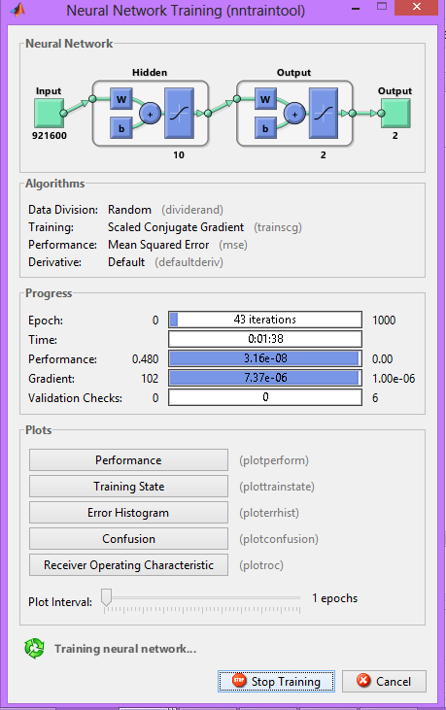
Software Workings-
Neural Network Training-

Slide 7
This window is displayed when the neural network is being trained with the test images. The training progress can be monitored in real-time by the progress bars in the window. Also, to check the correctness and robustness of the neural model trained, provisions are there to plot the Confusion Matrix, Error Histogram etc.

Slide 8
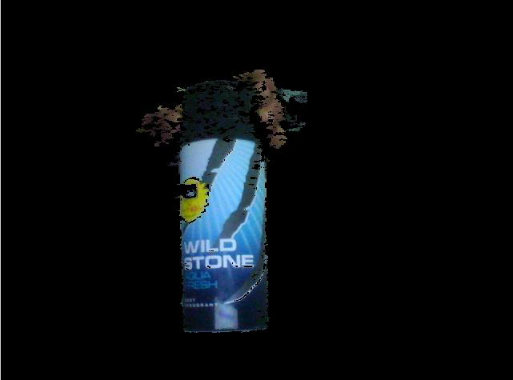
Background Removal -

Slide 9
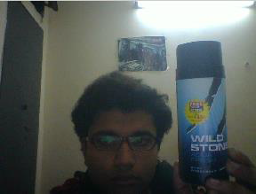
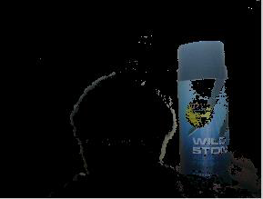

Slide 10
Illustrated previously is the process of background removal. The algorithm involves subtracting the input image from a reference image which is assumed to be the background. To account for the change in the environment and lighting conditions, the reference image is changed adaptively. For this purpose, a difference image is calculated by initially subtracting the input image from the previous reference image. This difference image is then subsequently converted into grayscale, and its histogram is analysed.
The double derivative at each point on the histogram is discretely calculated, and the point having the maximum value is found out. Following this, the histogram is integrated from the beginning to this point using simple trapezoidal integration. The value so obtained is divided by the total number of pixels to get a value denoting the “amount of darkness” in the image.

Slide 11
Furthermore, this quantity is also calculated at the corners and a few more specific areas of the image. All the quantities are finally then added and averaged to get a final quantity termed bFactor.
The value of bFactor lies in different ranges for object detection and background distortion respectively. This is used to adaptively control the reference image according to the lighting conditions. It is illustrated ahead.

Slide 12
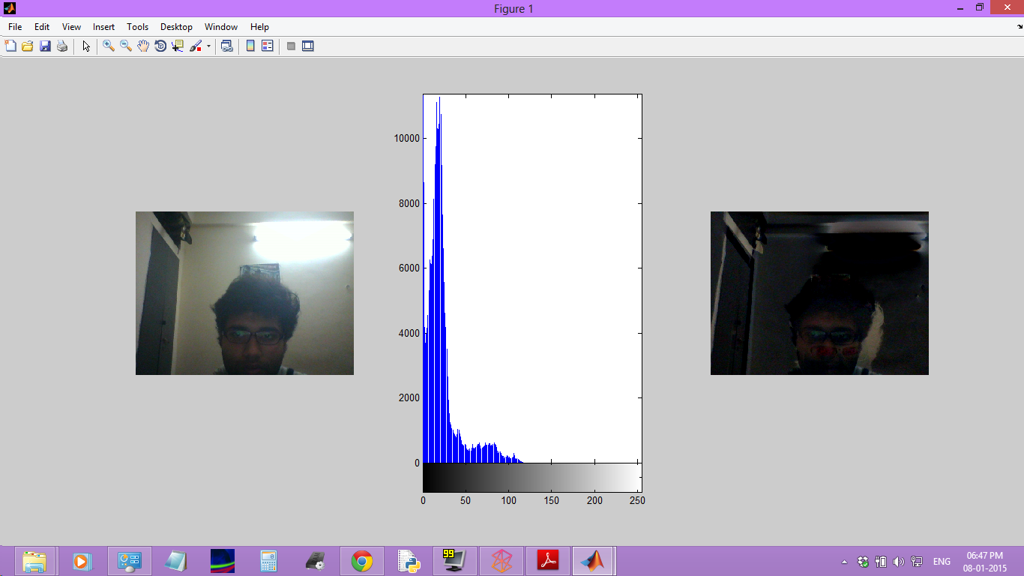
Distortion in background

Slide 13
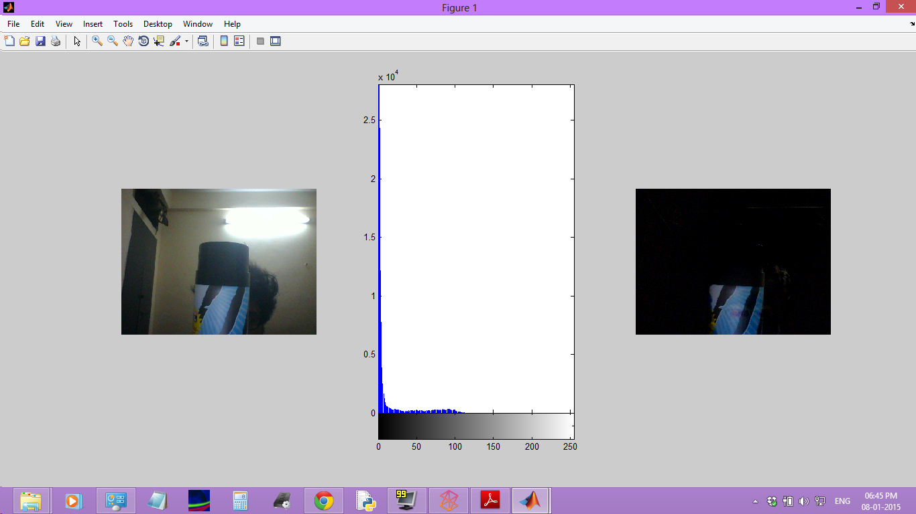
Object in front of Camera

Slide 14
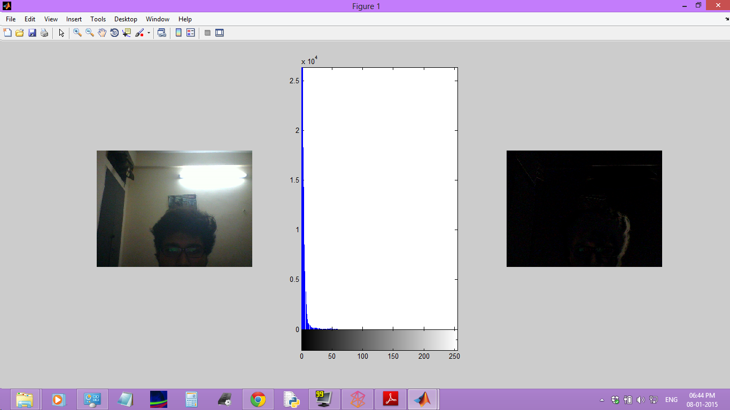
Normal Background

Slide 15
Expansion Scope-
The software maybe enhanced to incorporate automatic invoice generation and billing.
Also, a cross-platform solution may also be developed with not much effort in the Java language due to similarities in the semantic and syntactical structure of C# and Java.

Slide 16
Development Softwares Used -
Visual Studio 2012-
Visual Studio Software is a comprehensive software development IDE from Microsoft which allows for software development for any windows based platform in various languages.
Since this application is .NET based, hence this IDE was utilised. This IDE is also the only IDE to support building, and live debugging of Windows Phone Apps on real devices.

Slide 17
MATLAB-
This software is used to write the scripts handled the various computationally intensive tasks of background removal from images and the implementation of Neural Networks. MATLAB greatly eases the work of a developer especially if it involves hard to implement computationally intensive algorithms.

Slide 18
Bibliography
www.stackoverflow.com
www.codeproject.com
www.dreamincode.com
www.msdn.microsoft.com

